Slide 1
1
Project Title: Design and Implementation of a Mobile App for QoE Data Collection
Task 4: System Modelling and Design
Course Code and Title: CEF440 Internet Programming and Mobile Programming
Course Instructor: Dr. Nkemeni Valery
Presented by Group13

Slide 2
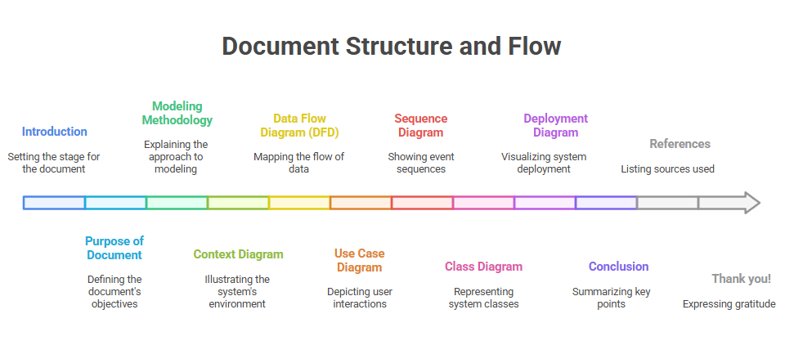
2
Presentation Overview
Introduction
Purpose of Document
Modeling Methodology
Context Diagram
Data Flow Diagram (DFD)
Use Case Diagram
Class Diagram
Deployment Diagram
Sequence Diagram

Slide 3
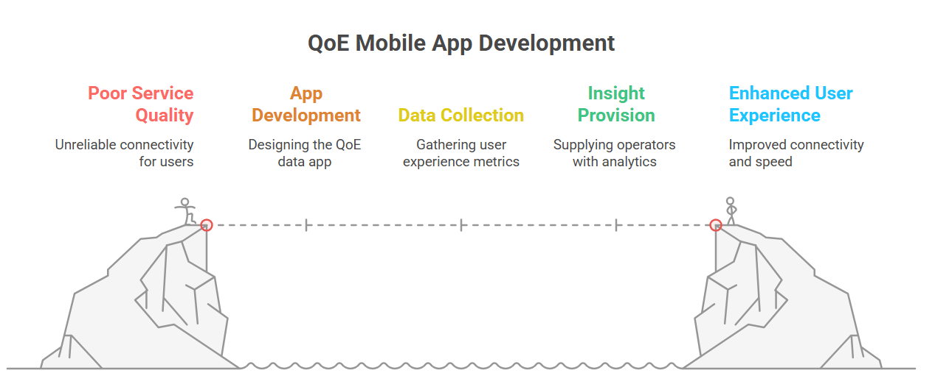
3
Introduction
This presentation outlines the development of a mobile application aimed at collecting Quality of Experience (QoE) data from mobile network subscribers in Cameroon. By addressing service quality issues such as unreliable connectivity and slow internet speeds, the app enhances user experience and provides valuable insights to operators.

Slide 4
4
Purpose of the Document
The document serves as a guide for the design and modeling of the QoE mobile app. It utilizes UML diagrams to structure system design, ensuring traceability between design elements and project requirements.

Slide 5
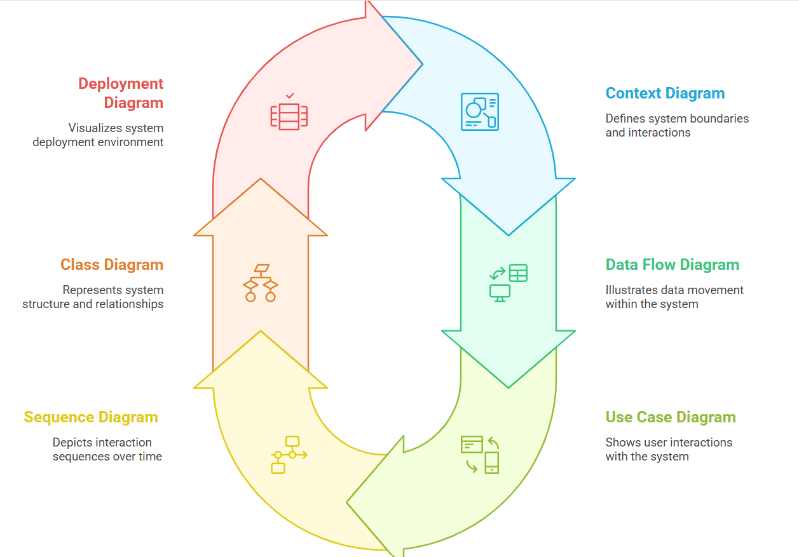
5
Modeling Methodology
Follows structured design through UML diagrams. Incorporates various models including Context, Data Flow, Use Case, Sequence, Class, and Deployment Diagrams.

Slide 6
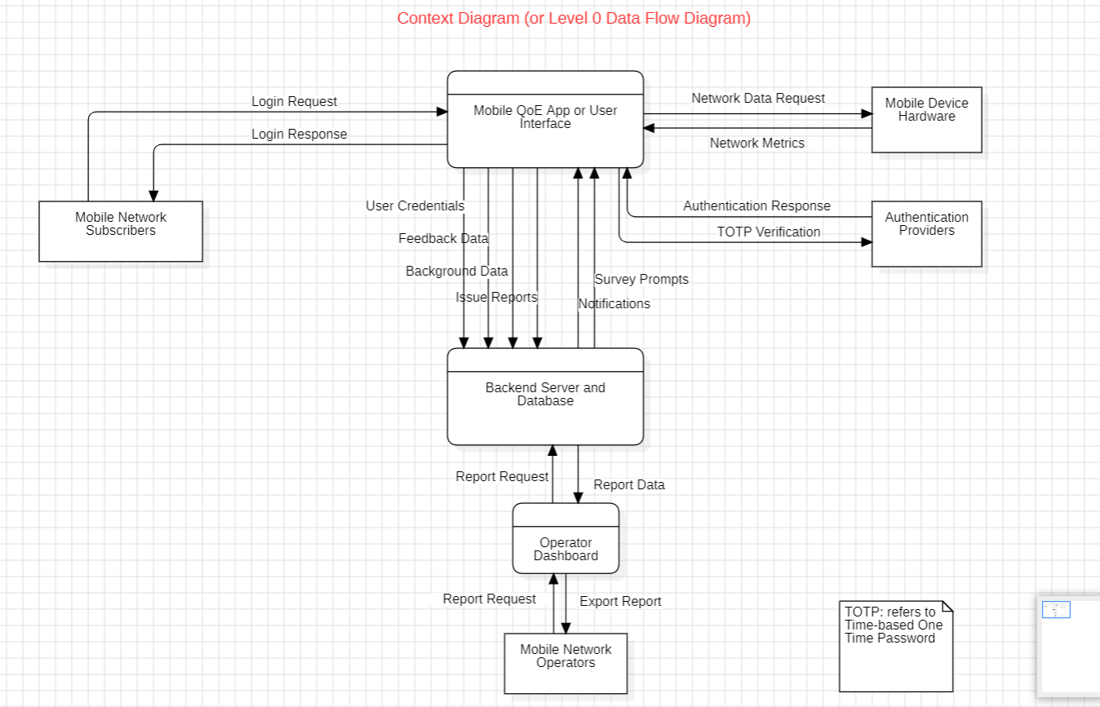
6
Context Diagram (CD)

Slide 7
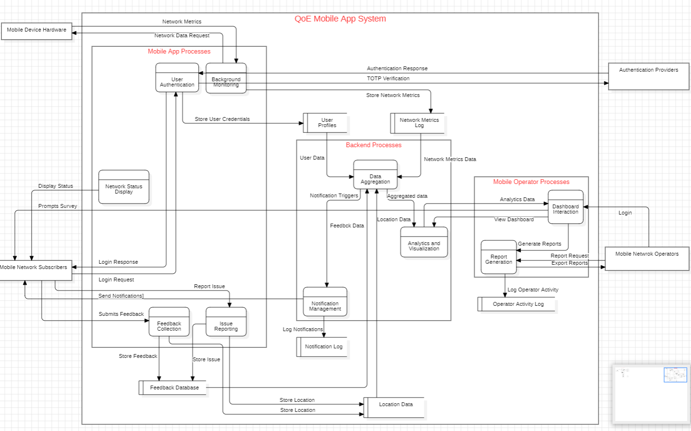
7
Data Flow Diagram (DFD)

Slide 8
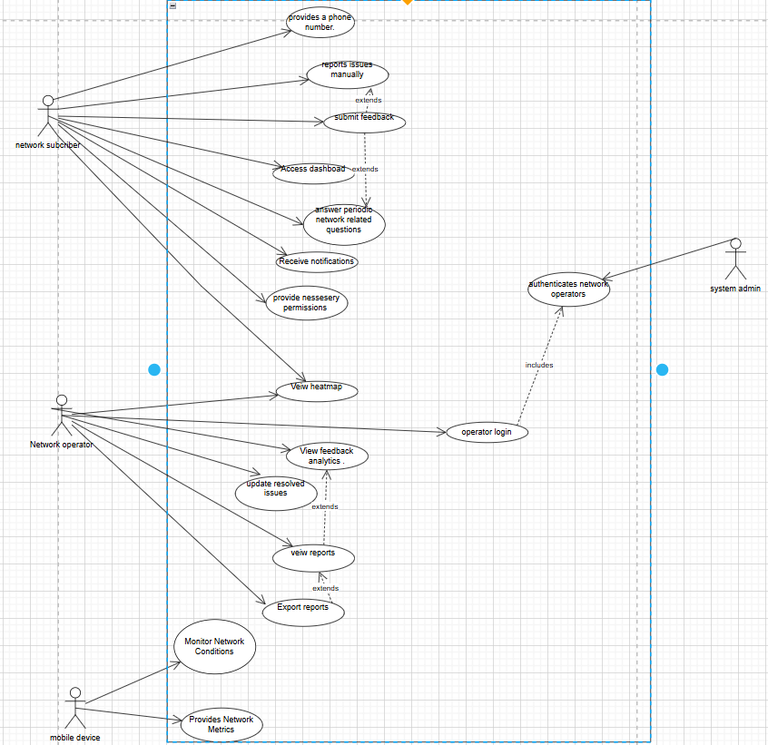
8
Use Case Diagram (UCD)

Slide 9
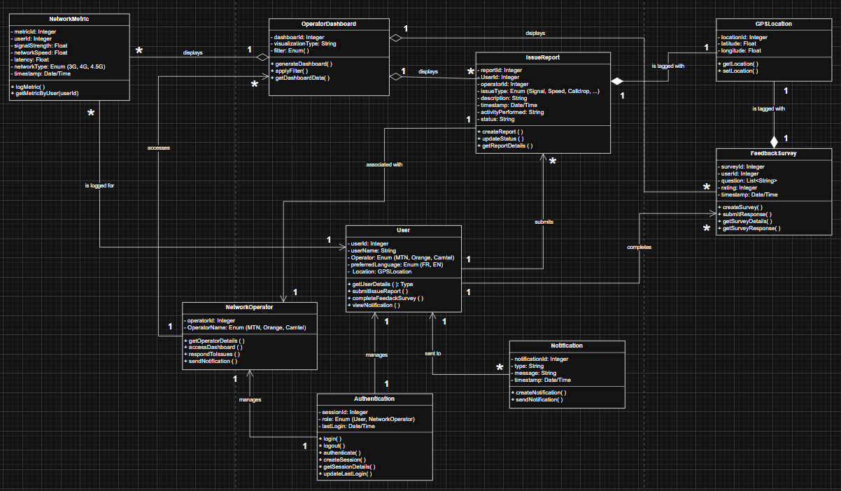
9
Class Diagram

Slide 10
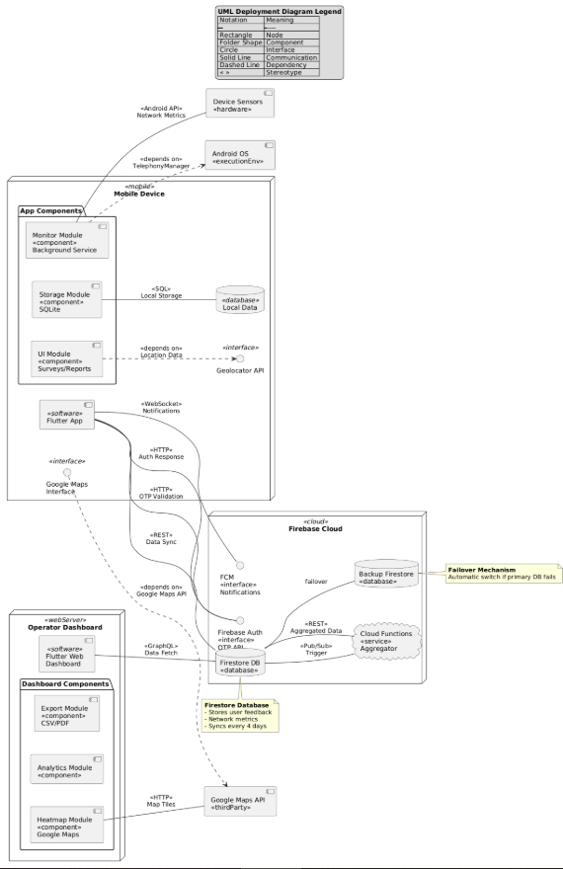
Deployment Diagram (DD)
10

Slide 11
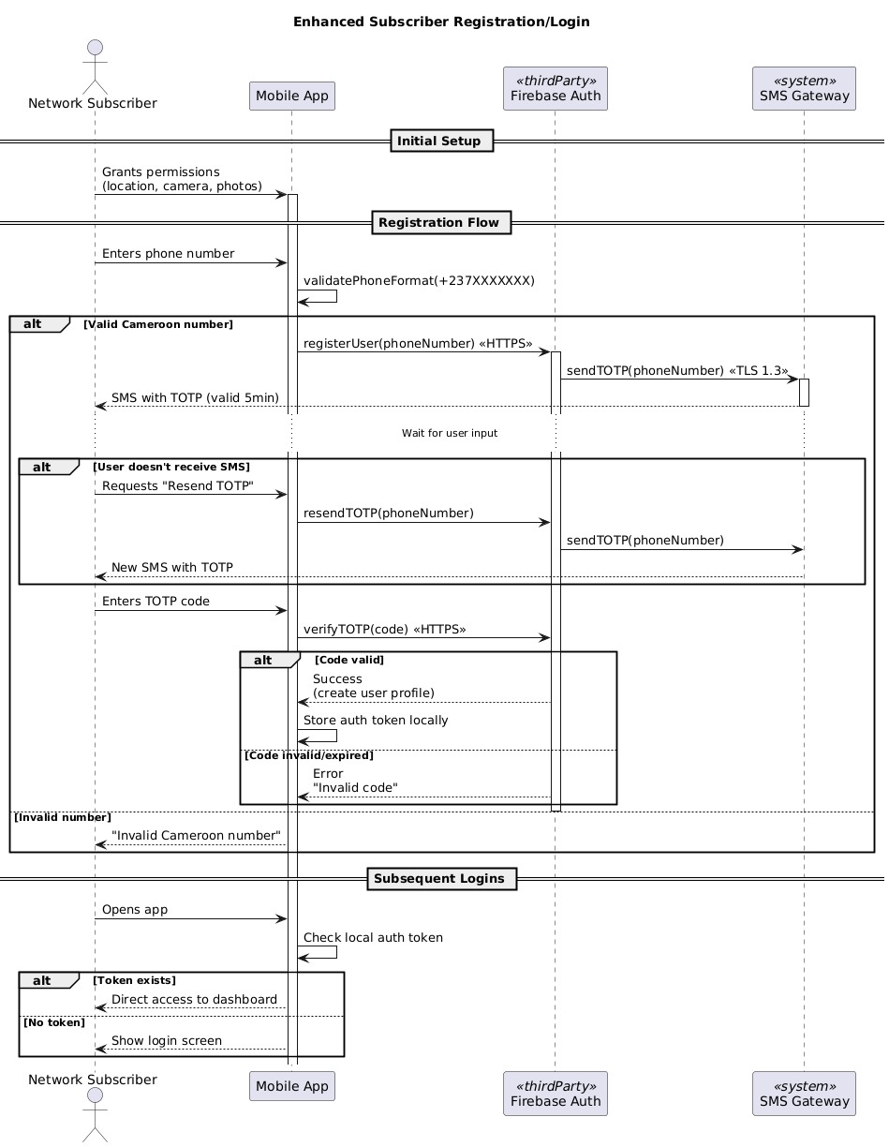
Sequence Diagram (SD)-1
11

Slide 12
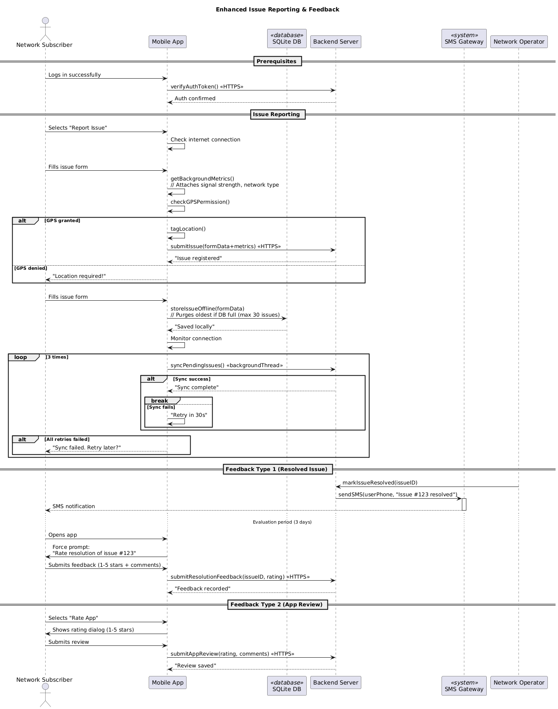
12
Sequence Diagram (SD)-2

Slide 13
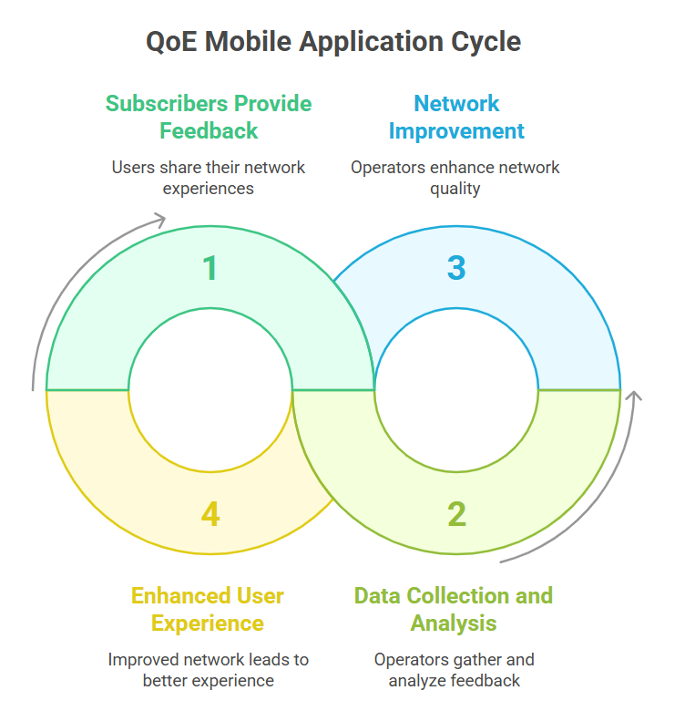
Conclusion
13
The QoE mobile application represents a significant step in improving mobile network quality in Cameroon by providing a platform for subscribers to voice their experiences while empowering operators with critical data insights for network improvement.

Slide 14
14
References
Unified Modeling Language (UML) Guides for System Design.
Mobile Network Quality of Experience Research Report Documentation.

Slide 15
15
Thank you!
Do you have any questions?

